Slide 1
A.I. in Aviation Workshop
Hyuntae Jung
28th June, 2018

Slide 2

Workshop Objective
promote the general interest of A.I. within ICAO
To deliver an illustration of Artificial Intelligence in aviation
with both a high-level and a technical component

Slide 3



Workshop Structure
Session I
Session II
Session III
The overview and impact of Artificial Intelligence
Exercise: let’s make our own machine learning application
How does a machine learn?
* Laptop required for the programming
High-level overview
Technical Components

Slide 4
Workshop Schedule
Time | Duration | Room | Session
09:30 – 10:40 | 1 H 10 min | AN Conf 7.15.55 | Session I. What is A.I. and why do we need to pay attention now?
Inter-session Break (10 min)
10:50 – 12:00 | 1 H 10 min | AN Conf 7.15.55 | Session II. How does a machine learn?
Lunch Break (60 min)
13:00 – 15:00 | 2 H | AN Conf 7.15.55 | Session III. Exercise: let’s make our own machine learning application.

Slide 5
Session I.
What is A.I. and why do we need to pay attention now?
The overview and impact of A.I. and Machine Learning in aviation industry.

Slide 6


Introduction
Name
Hyuntae Jung
Background
Supervisor
Yuri Fattah
Air Traffic Control
Artificial Intelligence
Duration
Jan. ~ Jun. 2018 (6 months)
Worked with
Multidisciplinary Priorities
Integrated Aviation Analysis
Airspace Management and Optimization
+
Air Operation Assistant (ROK Air Force) – 2 years
Research Assistant (Korea & Japan) – 3 years

Slide 7
But… Why A.I.?
Why did an aviation guy studied A.I.?

Slide 8
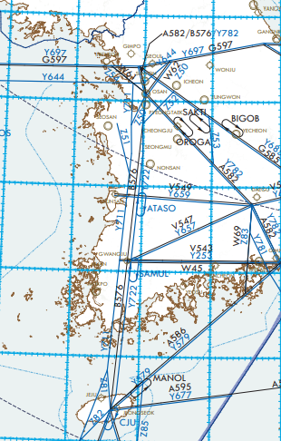
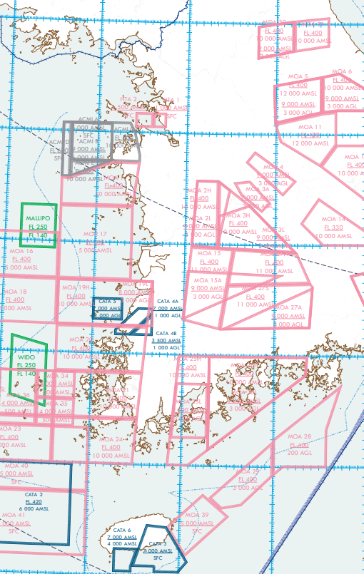
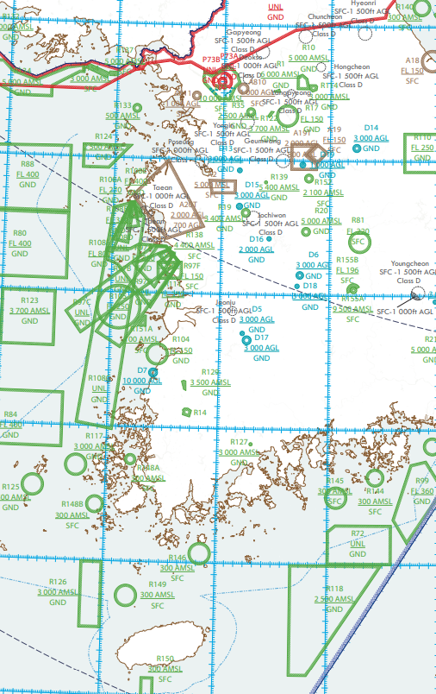
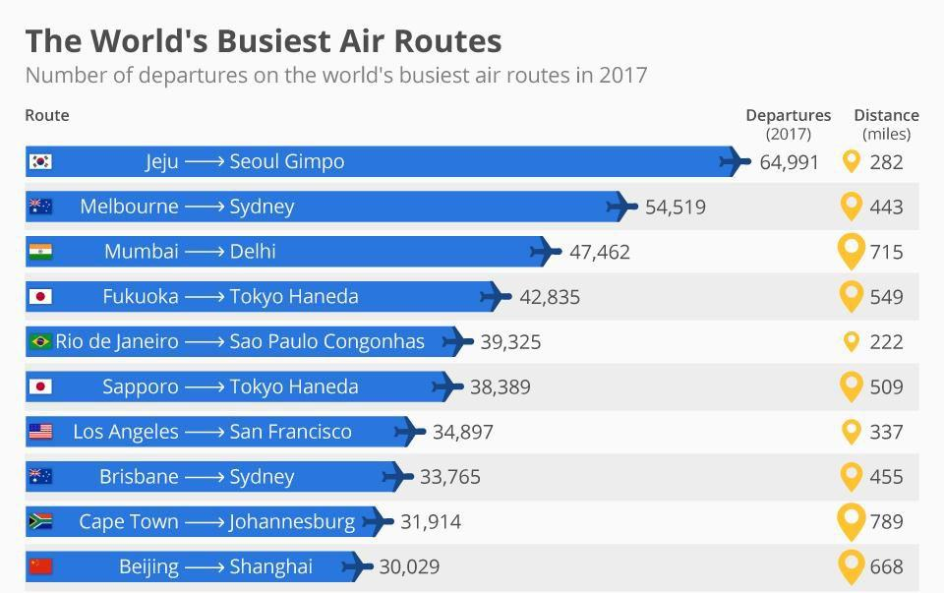
Background

Slide 9

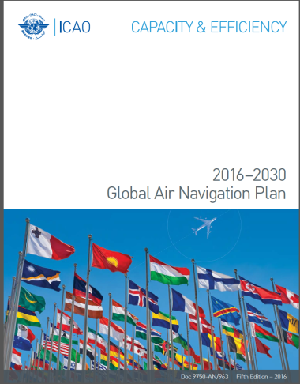
Background
Shouldn’t be there a better way to manage air traffic?
Air Traffic Management
Global Air Navigation Plan
Aviation System Block Upgrade
Student ATCo

Slide 10
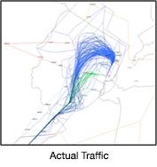
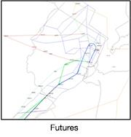
Trajectory Based Operation
TBO in Nutshell
4D flight trajectories are shared and managed…
“we know the accurate future traffic flow”
1
to all stakeholders
2
real-time data for Collaborative Decision Making
System-wide performance optimization
3
in advance and during the flight
Efficient, predictable, flexible operation
Full deployment planned in ASBU Block 3 (2031) & Block 4 (2037)

Slide 11


Trajectory Based Operation
TBO can be achieved with automation technologies
it is almost impossible for human to identify, track or manage every trajectories with low-level calculations.
Information Exchange
Capacity
Information
AU
ASP
ASP
even more machine support!
TBO
FF-ICE ?
FMS ?
Conventional Operation
Notes:
Handle information beyond human capacity: real-time big data exchange.
Automation required to coop and handle the explosive information.

Slide 12
A.I. is the game changer
Why?

Slide 13
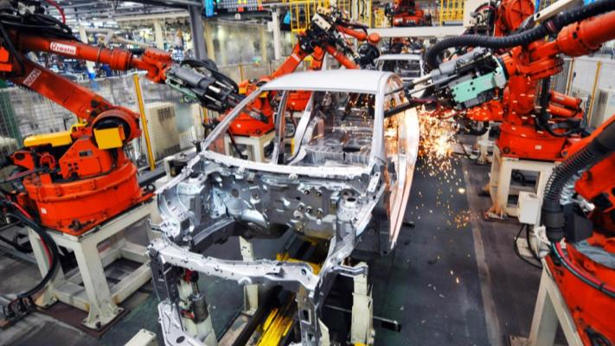

Automation
Artificial Intelligence
Mechanical Muscle
Mechanical Mind
Replacing repetitive human physical labor
Replacing repetitive human mental labor?
Stronger, reliable and more tireless than human muscle.
Better cost, time and accuracy
Theoretically, AI is capable of what human brains are capable of.
Only cost-effective in narrow situations

Slide 14
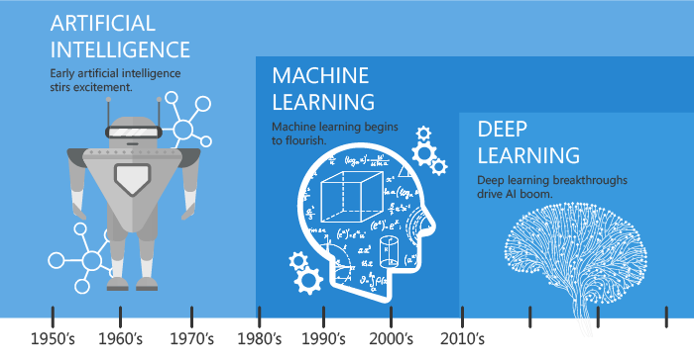

Slide 15
Traditional Expert System (~1990s)
Modern Machine Learning (2010s)
If…
Data
Predict
If…
If…
Action
Action
Action
Action
Architecture by human design, not data
Machine learns itself from huge data
Built to beat human performance
Built to mimic human decision
Once built, cannot improve without changing the architecture
Continuously evolve by feedback from data and prediction

Slide 16







A.I. in Nutshell:
Predict as similar as possible to actual result by capturing the pattern in data
Human behaviors
Data
AI Bot
Train & Evaluate
Validation

Slide 17























Decision Making
Decision Level
?
!
Capacity
/ Demand
Go vs No go problem
Process
Time
Strategic Planning
Intelligence Level
Problem Identification, Scenarios & Solutions
Solution: linking “status” to “action” from combined information.
Data-Driven Decision Making
Evaluation, Validation and Screening
Information Level
Status
Human-friendly, Processed information.
Predictions
Indicator
Statistics
Trend
Data Level
Data Exchange
Big-Data
Hardly readable, huge volume and real-time data
Reports
Reporting System
Field Level
Data Mining
Where real things are happening
Field

Slide 18
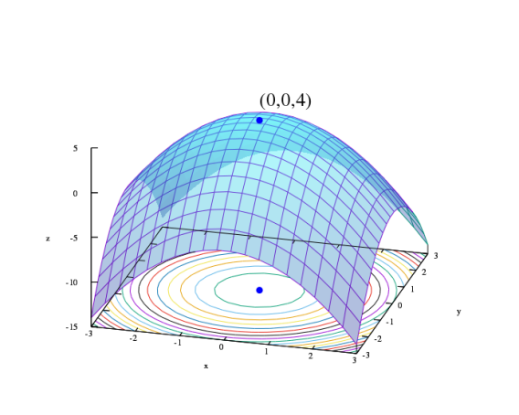
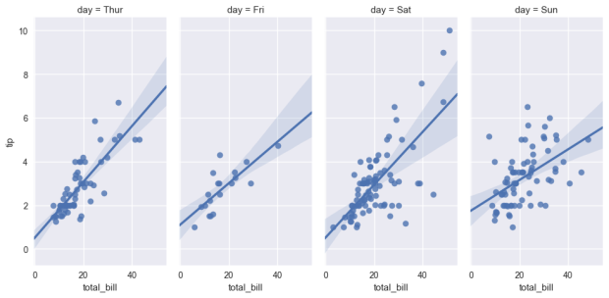
Solution: Prediction and Optimization
Regression & Prediction
Optimization
Machine Learning
Capture the best link that explains correlation between data.
Find the best solution which fits the objective, with satisfying given constraints.
Supervised Learning
Classification
Regression
Unsupervised Learning
Clustering
Feature Analytics
Reinforcement Learning
React from environment

Slide 19
Sense & Respond
Predict & Act
Optimization
Competitive Advantage
Predictive Modeling
What is the best that could happen?
Generic Analytics
Ad Hoc Reports
What will happen?
Standard Reports
Raw Data
Cleaned Data
Why did it happen?
What happened?
Analytics Maturity

Slide 20
Towards Predictive Era

Slide 21



Reactive, Proactive and Predictive
Reactive
Proactive
Predictive
Past
Present
Future
Responds to past events that have already happened.
“Fix when broken”
Actively seeks the identification of current conditions.
Analyzes the system processes and environment to identify future problems.

Slide 22
Aviation in Predictive Era
Optimization & Resource Allocation
Autonomous Support and Augmented Intelligence
Analysis and Prediction
Predictive Risk Management
(Safety Management)
Air Traffic Management
Demand-Capacity Balancing
Drones (Autonomous)
Chat-bot for Passenger Support
Predictive Maintenance (MRO)
System-wide Performance Optimization
Decision Support Tool for Flight Operation & ATC.
Passenger Demand & Traffic Growth Prediction
Airline Revenue Management
Training Support
Weather Forecast
Dynamic Resource Allocation (e.g. Service Kiosk in Terminal)
Data-Driven Decision Making (Policy and Governance)
Security and Facilitation

Slide 23
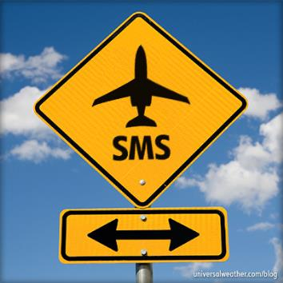
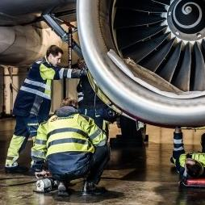
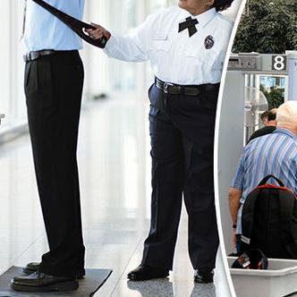


Analysis and Prediction in Aviation
→ Enables to see the future
Predictive Risk Management
Predictive Maintenance
Risk-based Aviation Security
Weather Forecast
Demand & Traffic Prediction

Slide 24
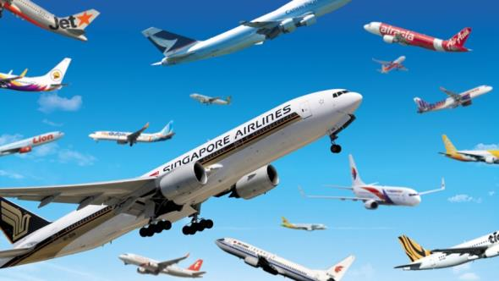
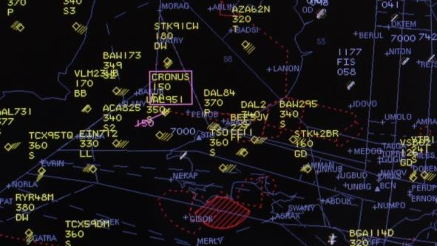
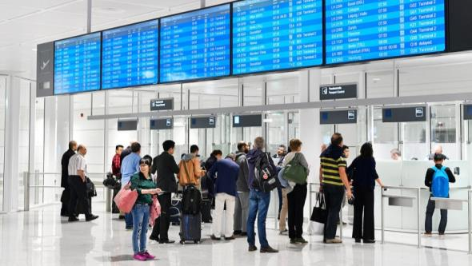
Optimization in Aviation
→ Enables system-wide performance optimization
Airline Revenue Management
Air Traffic Management
Airport Terminal Resource Allocation
Maximize revenue, minimize cost
Maximize efficiency, minimize hazard
Maximize utility, minimize cost

Slide 25
How about in ICAO?

Slide 26




Artificial Intelligence for ICAO
Supporting decision making process
Artificial Intelligence for
Data-Driven Decision Making
Evaluate, Identify and driving solution
Document and context reading, summarization, conflict detection and writing
Artificial Intelligence for
ATM Configuration
Artificial Intelligence for
Safety Data Analysis
Enabler of future ATM concepts
Cost and time effective + high accuracy
Optimized resource allocation & maximized utilization of infrastructure
Continuous and predictive safety improvement through feedback

Slide 27





Artificial Intelligence and Strategic Objective
→ A.I. would be capable of supporting all of our works soon.
Predictive SMS
Maximize utilization of infrastructure
Risk-based management
Economic analysis and forecasting
Emission monitoring, evaluation and analysis
Continuous Monitoring
Anomaly detection
System Optimization
Resource Allocation
Modeling, simulation and prediction
Risk & Crisis analysis
Performance-based
Air Traffic Management
Joint data sharing and coordination
Face recognition + Biometric data
Implementation support
State support

Slide 28









Artificial Intelligence and No Country Left Behind
→ Building an A.I. is expensive, but using one is easy.
or almost
Researching
Building
Distributing
Using

Slide 29
A.I. for Our Works

Slide 30

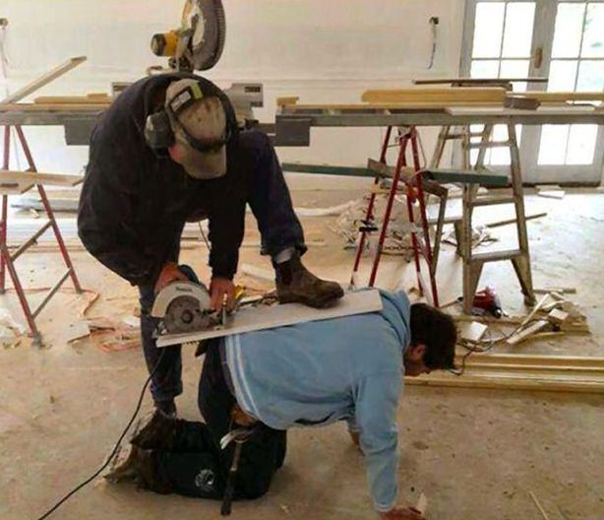

Slide 31
How to write a new paper (for humor)
Step 1.
Go read all the documents
Step 2.
Search for all potential conflicts
Step 3.
Discover a random item that you don’t really know about
Step 4.
Ask people for someone who know about it
Step 5.
Find out that they are on the vacation
Step 6.
Discover an ancient document that nobody actually cares, but conflicts with yours
Step 7.
Deal with random questions from those are unhappy about your idea
Step 8.
No idea what you are doing right now, but proceed anyway
Step 9.
Find out someone already did it
Too complex for A.I. to handle?
Complex works can be broken down into sets of simple tasks.

Slide 32
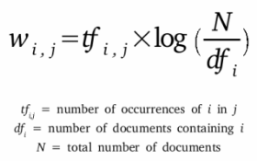
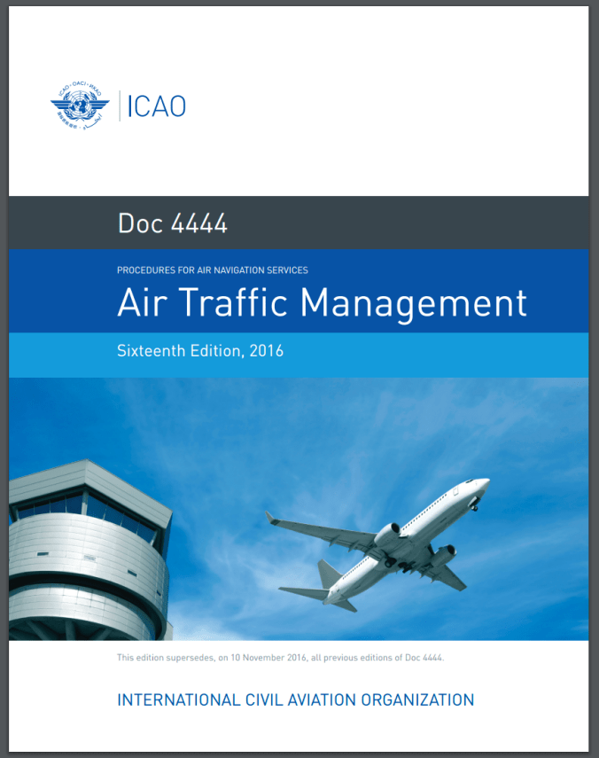
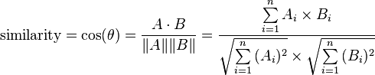
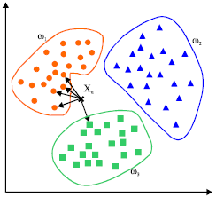
Example 1. ICAO Document Analysis
international standards and recommended practices air traffic control service flight information service alerting service doc 4444 sixteenth edition, 2016 air traffic management procedures for air navigation services…
the 9056 0.5890
and 2896 2.0352
in 2482 0.2471
aircraft 2041 0.3323
shall 1217 0.8951
flight 1071 1.5805
traffic 927 5.2799
control 746 1.9639
information 667 5.3957
Count words & Calculate TF-IDF

Slide 33
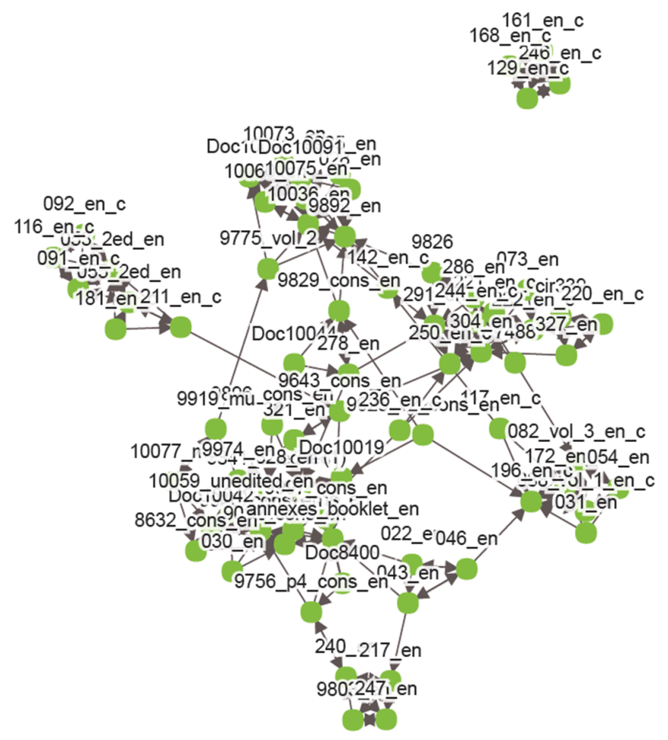
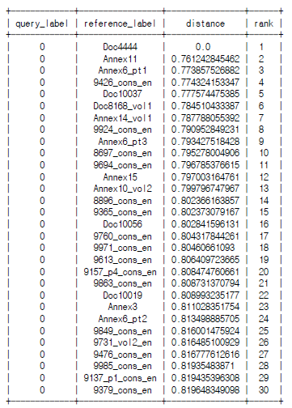
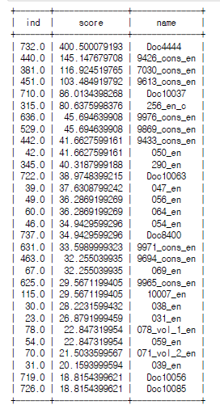
Document distance
Example: PANS-ATM (Doc 4444)
Keyword approach
Example: “flight plan”

Slide 34
Example 2. Fake Report Generator
… the future development of international civil aviation …
… the future development of international civil _viation …
t
t
8%
c
f
13%
blank
a
v
r
v
t
r
67%
a
32%
i
5%
m
m

Slide 37
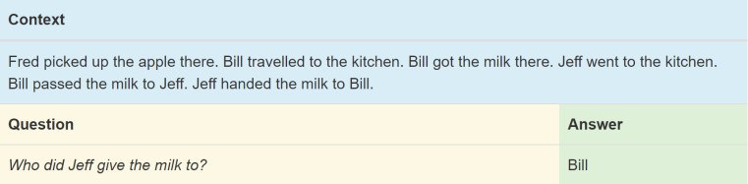
Question & Answering

Slide 38
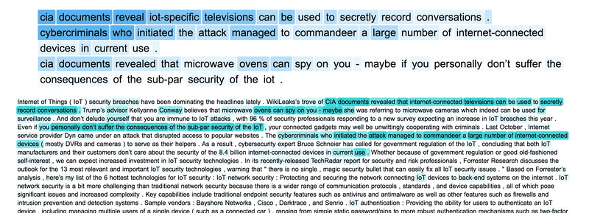
Summarizing

Slide 39
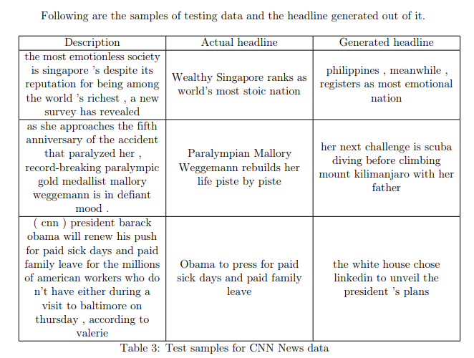

Slide 40
What do we need?

Slide 41







Data, Data and more Data
→ Data is the fuel of A.I.
Data Source
Accessible Data
Artificial Intelligence
Human-Machine Interface

Slide 42
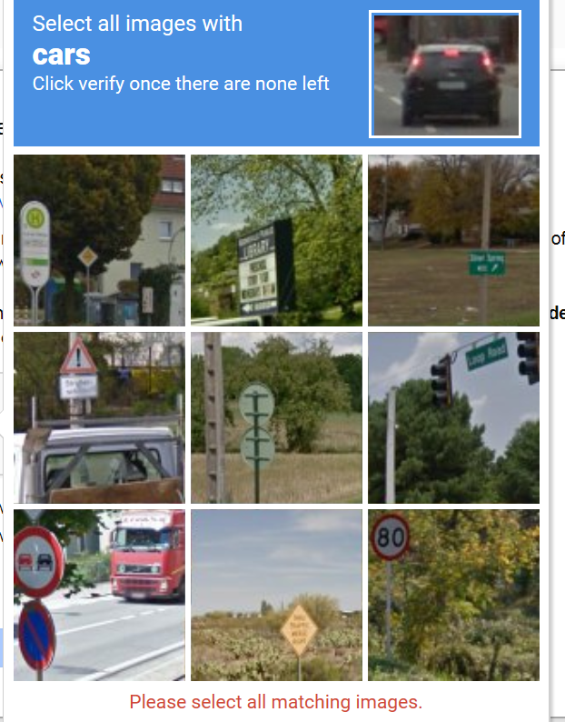
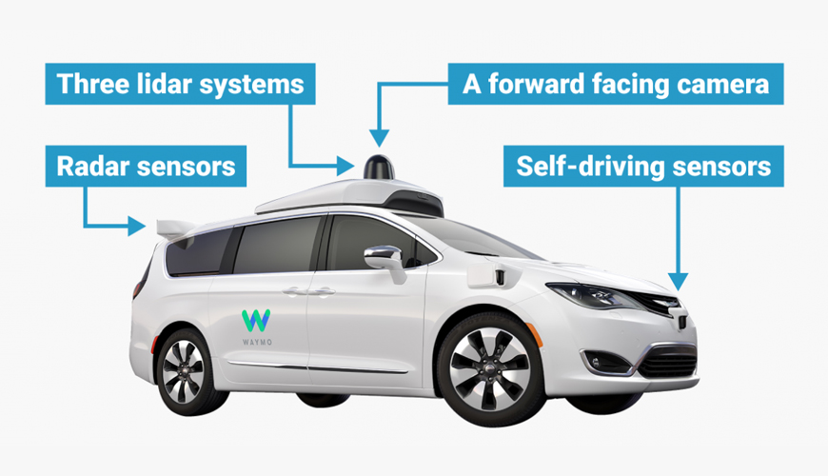

Slide 43
A.I. at the peak of inflated expectations

Slide 44
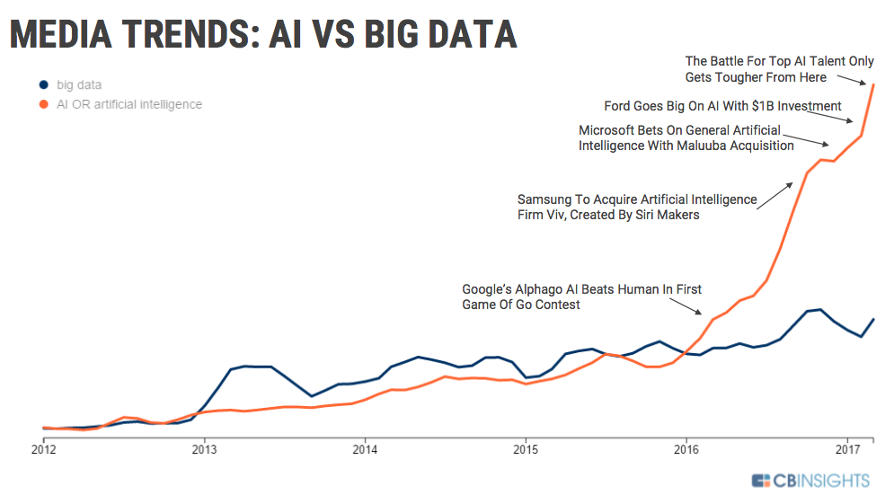
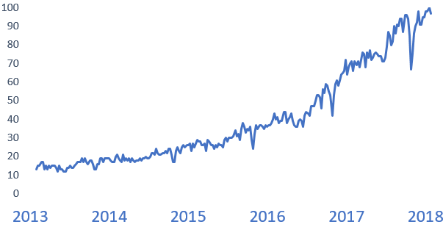
The “A.I. Hype”
Google Trends search for machine learning

Slide 45
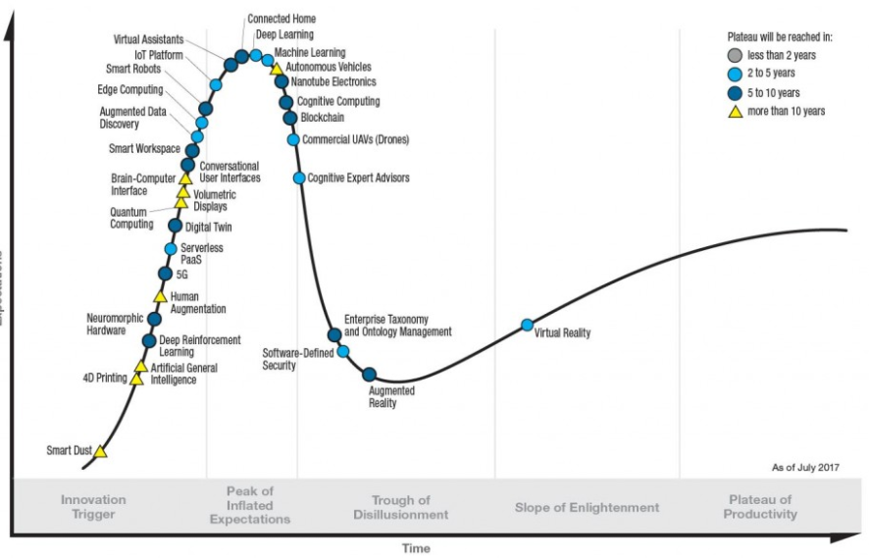
Bursting the Bubble: Gartner’s Hype Cycle
Everybody is using artificial intelligence ‘without knowing it’
There is a significant gap between expectation and technological level.
The current level of Artificial Intelligence is not “Artificial Intelligent”.
Leaving the very peak of the hype cycle is not a bad thing.
By entering so-called Slope of Enlightenment, the technology’s applications start to crystallize.

Slide 46
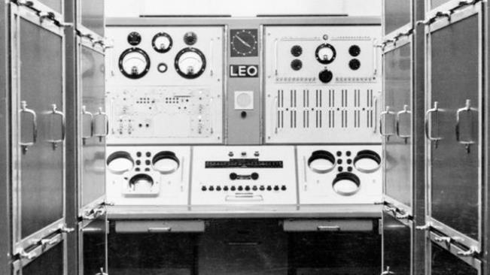
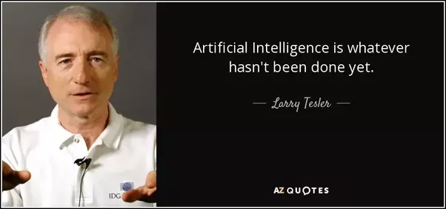
Then, is the A.I. unreachable?
→ Notion and expectation of A.I. evolves as technology did
“We don’t know what A.I. is capable of yet.”
"Electronic brains. Science fiction stuff? No. It's Britain's first computer exhibition at London's Olympia,“ 1960s
We are making a progress!

Slide 47
Challenges

Slide 48
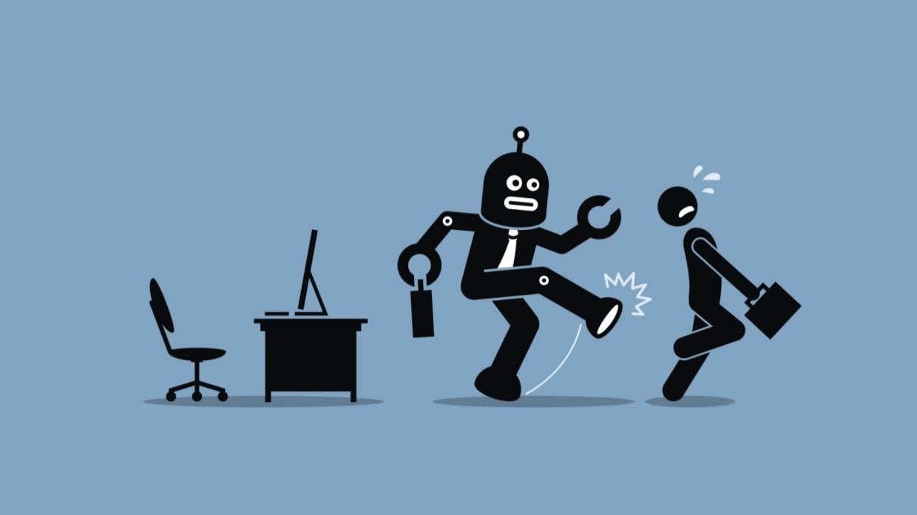
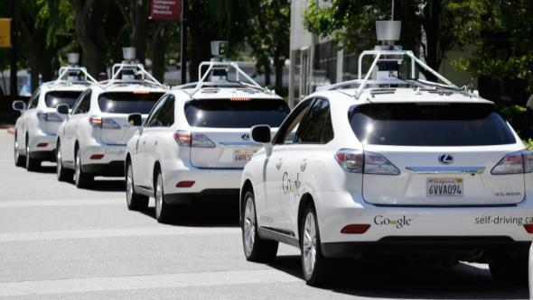

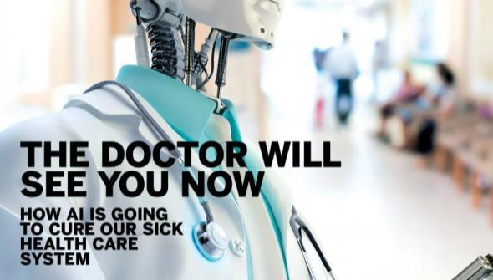

Slide 49
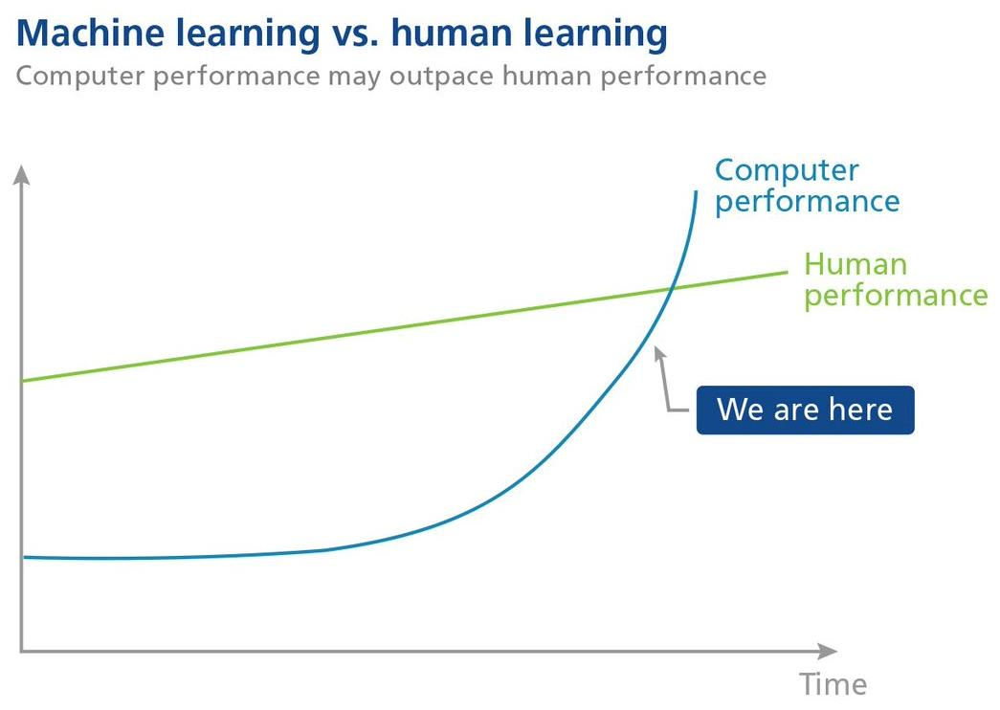

Slide 50
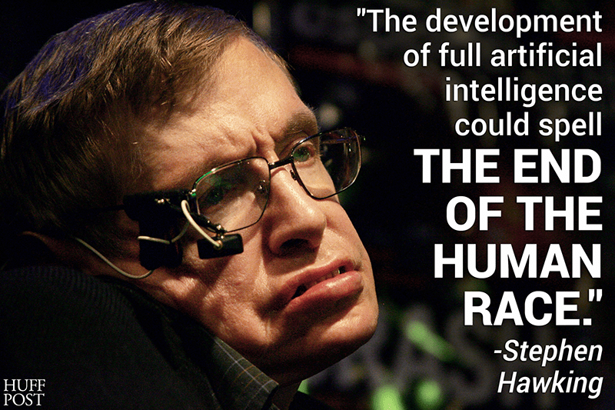
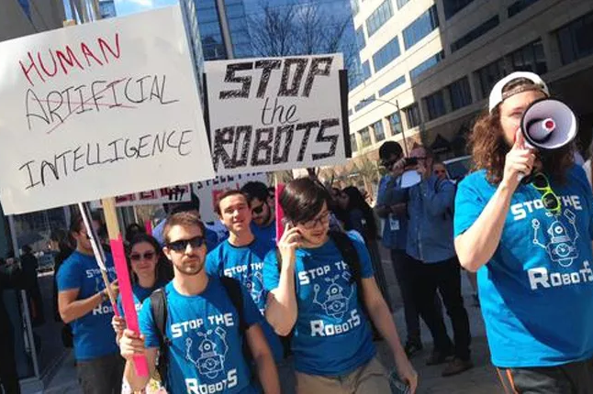

Slide 51


Challenges lie upon Artificial Intelligence era
Task for human
Decision-making
Flexible for embracing new concepts
Resolving conflicts
Setting directions
Accessible for everybody in everywhere
Task for machine
Co-existence
A.I. to follow our decision-making process.
Low-level calculation
Real-time big data handling
Let humans do what humans are good at, and machines do what machines are good at.
Simple repetitive works
→ A.I. to support us, not to replace us.
Humans will always be part of the design, and management of the system.
Notes:
Motivation – Why do we need to build an A.I.
Human cannot deal with information explosion; we need ‘sidekicks’.
We can focus on what we are good at, and let machines do what machines are good at.
A.I. built in proper way would enable the aviation industry to embrace new concepts, make it accessible for everybody in everywhere.
In accordance with how civil aviation has been ensured safety and stability, the A.I. shall be managed to not evolve by itself, but to follow human decision-making process.
Therefore, we need data that shows how we have done so far to build A.I. that think in our way.

Slide 52
Why ICAO needs to consider Artificial Intelligence
→ Artificial Intelligence for international aviation community.
Opportunities
Threats
Justification
Can manage complexity through decision support tool.
Technological advancement will exceed the speed of how social or policy adapts.
The strategic objectives and No Country Left Behind initiative can be further achieved with the support of Artificial Intelligence.
Beneficial to bridge the gap between States: does not require heavy and expensive infrastructure
Enormous impact and concerns of representing only the specific interest of few people.
ICAO needs to protect equity by providing globally harmonized and open accessibility to the Artificial Intelligence for global aviation community.

Slide 53
Conclusion

Slide 54
Conclusion: Innovation
Delusion vs Optimism
Knowledge and Roadmap: Know what it is / How to achieve it / Which direction to go
The safest aircraft?
The airplane on the ground is safe, but that is not what airplanes are built for
Innovative mind
Things are changing very fast, and going to be even faster.

Slide 55

Artificial Intelligence is fascinating and also very scary.
→ We need you on-board!
It is “revolutionary” – not just another technology
We don’t know what A.I. is capable of, and how A.I. would change our society.
One thing for sure: “We are not letting machine to decide our destiny.”
We need a public consensus, and your participation.

Slide 56















Artificial Intelligence is open to everyone.
→ You don’t need money to start your own Machine Learning
Education
Development
Open Library
Open Codes

Slide 57
Q & A

